Slide 1
Network Security - Homework 3
Apoorv Gahlot

Slide 2
Table of Contents
Overview
Project Goals
Project Execution Highlights
Security Policy
Overview of Threat Model
Objectives Achieved
What was Learned

Slide 3
Overview
In this Homework, we are running a Nginx Server in a Docker Container with Default Settings
Our Goal is to Launch a DoS Attacks on this Nginx Server and make an inference from the results of the attack
Modifying the Nginx server’s settings to improve defences against DoS, repeating the DoS attacks again, and make an inference from the results of the attack.
Lastly, Installing and configuring Suricata to detect the attack promptly and gather reporting details from it.

Slide 4
Project Goals
Configure the Nginx Web server in a Docker Container
Launch a Denial-of-Service Attack using Hping3 tool, collect wireshark packets, and analyse the results of the attack
Improve defences against Denial-of-Service attack by updating the Nginx Server Settings( nginx.Conf) and launch the Denial of Service attack again against the Nginx server.
Install and Configure Suricata correctly and so that it detect attacks in real time.

Slide 5
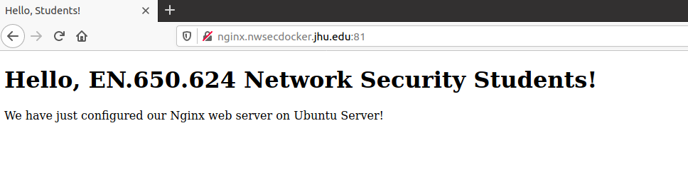
Project Execution
Built a Docker container running with the Nginx Webserver
Our goal is to crash the webserver using Denial-of-Service Attack
Tool Used for launching the DoS attack is Hping3

Slide 6
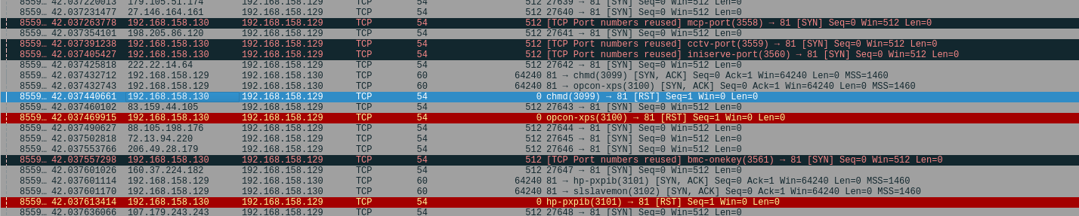
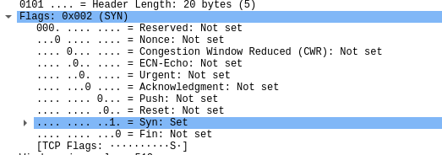
Project Execution
After launching the attack we monitor the traffic via the Wireshark and observe that hping3 is flooding the nginx server by synthesizing SYN packets from “pseudo-random” sources.

Slide 7
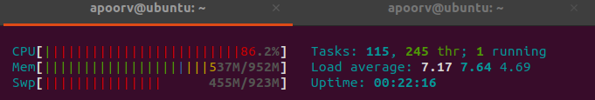
Project Execution
At Nginx server, we observe that the system resources are being depleted.
I was able to crash the server by decreasing the interval duration between each packet to 1 microsecond

Slide 8
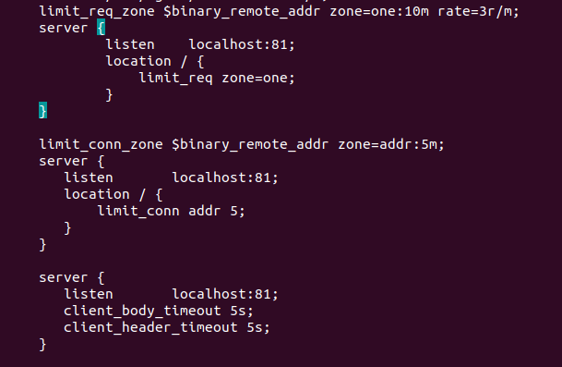
Project Execution
Improving Defenses:
Made changes to /etc/nginx/nginx.conf such as limiting rate of Requests and number of connections, closing slow connections etc
Configured IP Table rules to block Invalid packets, New Packets which were not SYN, Packets with Bogus TCP Flags and Uncommon MSS Values

Slide 9
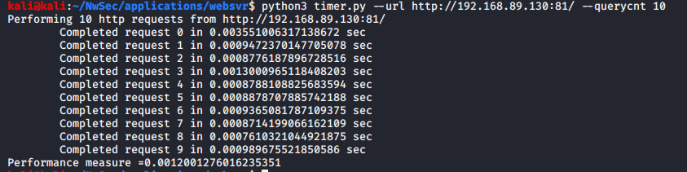
Project Execution
As a result, we observe that the Denial of Service this time were ineffective against our improved defences.
CPU usage was consistently around 2.4% and other system resources were not being depleted either ( There as No BLACK SCREEN this time)
Time take to complete 10 http requests was 0.0012 seconds

Slide 10
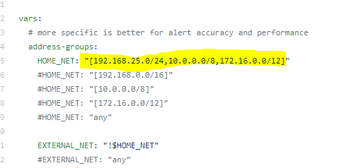
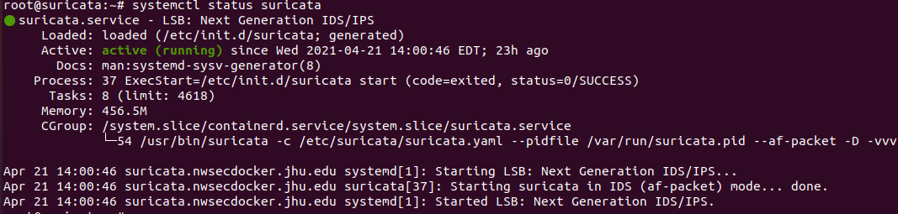
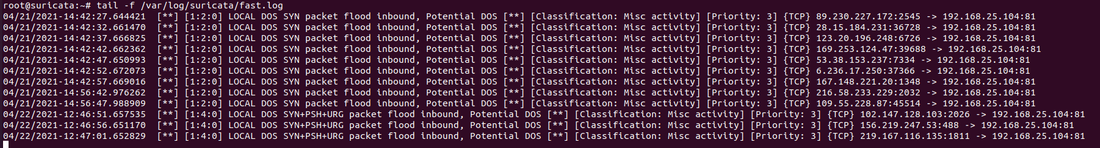
Project Execution
Next we configured the suricata to make sure it detected the attacks in real time.
Made user of tail command to detect attacks in real time.
Tail –f /var/log/suricata/fast.log
Log details can be found under /var/log/suricata directory

Slide 11
Network Security Policy/Recommendations
Proactively monitor network traffic around the clock, and request logs and graphs for servers each day from the hosting provider.
Overprovide bandwidth: It is a good idea to have more bandwidth available for services to accommodate unexpected surges in network traffic
Make sure that systems have adequate resources to complete the requests of legitimate users, especially when there is a surge in traffic.
Deploy IDS and IPS technologies, and leveraging Cloud technologies.
Defend the company’s network parameter by taking the following technical measures such as dropping malformed packets or setting a limit on the router

Slide 12
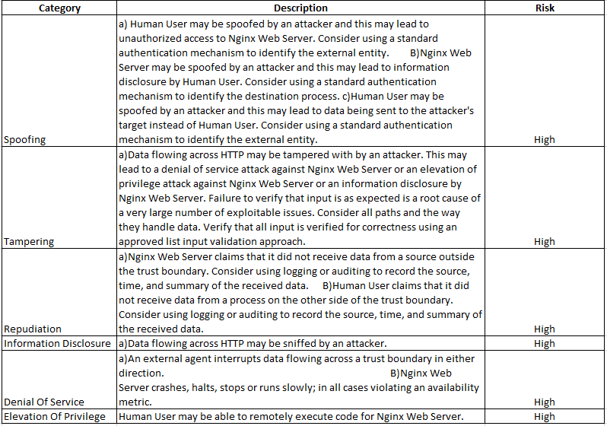
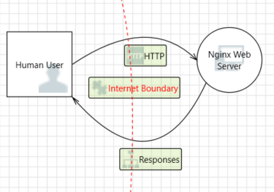
Overview Of Threat Model

Slide 13
Objectives Achieved
Successfully Configured the Nginx Web server in a Docker Container
Successfully Launched a Denial-of-Service Attack using Hping3 tool and crashed the Nginx Web Server
Improved the defences against Denial-of-Service attack by updating the Nginx Server Settings( nginx.Conf) and Iptables
Successfully Installed and Configured Suricata to make it detect attacks in real time.

Slide 14
Learnings
Before this assignment I had no idea what nginx server and suricata were. So I learned a great deal about these two technologies.
I learned about denial of service attacks and how to take precaution against these.
I also learned a lot of about networking concepts by setting up the infrastructure.
And Docker ! I realized the importance and efficiency of Docker Containers

Slide 15
The End
Thank You !

